Slide 1


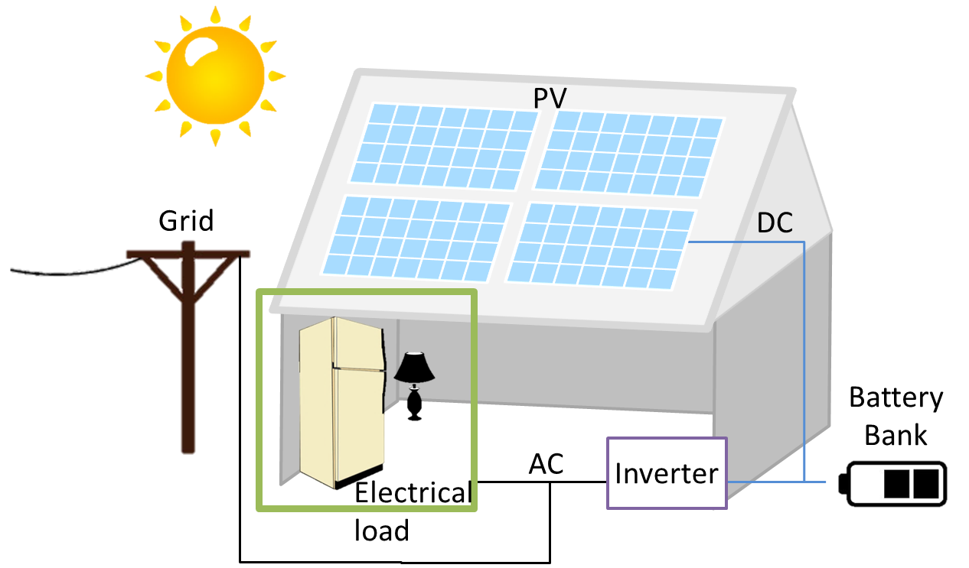

NSF REU 2019 Program
Cost-Benefit Analysis of Solar Batteries for a Single Residential Load in Tucson, Arizona
Lauren Lusk; Saleh Alharbi, Dr. M. A. Matin; NSF REU site director: David Wenzhong Gao
Abstract
As the price of solar panels continues to decrease, the number of solar installations in the U.S. increases. Arizona has some of the highest solar potentials in the US, and an increasing number of residents are taking advantage of tax credits and other incentives to use that potential to subsidize their grid use with solar home systems (SHS). SHS help to decrease homeowner’s electricity bills and can also be used to power the home in an emergency situation in island mode when the grid is off-line. However, in order to operate in island mode, the SHS must include a battery bank. This paper presents a cost-benefit analysis of batteries lead acid, lithium-ion, and saltwater commercially available batteries used in a HOMER simulated SHS in Tucson, Arizona.
Batteries
The chosen commercial batteries are as follows: Aquion Energy Aspen 24S83 (saltwater), Vision CT12-80X (sealed lead acid), and Next Gen 12V 80Ah (LiFePo4).
The goal of this project is to determine which battery has the best performance and lowest cost.
The number of batteries for all systems is determined by HOMER as the optimal number to serve the 10kWh islanded load
The net present cost (NPC) is computed by HOMER for the lifetime of the project (25 years)
The cost of energy (COE) is calculated by HOMER using the following equation [2]:
$$COE= C_{ann,tot}/E_{served}$$
The autonomy of the batteries in island mode is determined by the following equation [3]:
$$A_{batt}=\frac{N_{batt}V_{nom}Q_{nom}(1−{q_{min}}/{100})({24h}/d)}{L_{prim,ave}(\frac{1000\left[wh\right]}{[kWh]})}$$
Island Mode
Table 3: Number of batteries for all cases
Battery | # Batteries | Cost ($) | Total Capacity (kWh)
Saltwater | 5 | $5,895.00 | 9.96
Lead-acid | 14 | $6,004.46 | 13.44
Li-ion | 10 | $10,399.90 | 9.96
Tables 1-2: Battery characteristics; all information is based on a singular battery
Figure 4: Cost of energy for all cases
Table 4: Battery autonomy in island mode
Battery | Voltage (V) | Capacity (Ah) | Capacity (Wh) | Cost per battery ($) | Energy Cost ($/Wh) | Energy Density (Wh/kg)
Saltwater | 24 | 83 | 1992 | $1,179.00 | $0.59 | 16.89
Lead-acid | 12 | 80 | 960 | $428.89 | $0.45 | 34.03
Lithium-ion | 12 | 80 | 960 | $1,039.99 | $1.08 | 75.59
Battery | Autonomy for 10kWh system (hr)
Saltwater | 23.9
Lead-acid | 21.6
Li-ion | 18.4
Conclusion
Saltwater batteries are the most cost-effective batteries to use in a SHS in Tucson, AZ.
For all cases, the cost of energy of the saltwater batteries is the lowest
Has the lowest NPC for all cases and the highest battery autonomy.
Long life cycle and 100% DOD
Can be left at 0% capacity indefinitely without suffering noticeable drop in performance
Made of completely non-toxic materials and will therefore never explode or catch on fire
References
[1] W. Barber, "Arizona Commission Overhauls Rules for Net Metering, Distributed Generation", Renewable Energy World, 2017.
[2]“Levelized Cost of Energy", Homerenergy.com, 2019. [Online]. Available: https://www.homerenergy.com/products/pro/docs/latest/levelized_cost_of_energy.htmlAccessed: 05- Aug- 2019].
[3]"Battery Bank Autonomy", Homerenergy.com, 2019. [Online]. Available: https://www.homerenergy.com/products/pro/docs/latest/battery_bank_autonomy.html. [Accessed: 05- Aug- 2019].
Battery | # cycles to 80% capacity | Max DOD (%) | Height (in) | Width (in) | Length (in) | Weight (lbs)
Saltwater | 3000 | 100% | 36.8 | 13 | 12.2 | 260
Lead-acid | 950 | 30% | 7.44 | 4.53 | 22.2 | 62.2
Lithium-ion | 2000 | 90% | 8.9 | 6.75 | 12.75 | 28
Introduction
In 2017, the Arizona Corporation Commission (ACC) voted to replace net metering with net billing, which increases operation costs in grid-connected SHS without a BES [1].
Numerical Results
Methodology
Idealized models of each battery are created in HOMER Pro and simulated in both grid-connected and islanded systems.
Solar index, residential load profile, and grid price from Tucson, AZ, are input into HOMER.
Grid-connected systems supply 25, 30, and 35 kWh load while the island system supplies a 10 kWh load.
Aquion Energy
(saltwater)
Vision
(lead-acid)
NexGen (lithium-ion)
Figure 1: Solar home system (SHS) configuration
Figure 3: NCP of the grid-connected cases
Acknowledgement: This work is supported by the U.S. National Science Foundation Research Experience for Undergraduates (REU) program.
Notes:
Copyright Colin Purrington (http://colinpurrington.com/tips/academic/posterdesign).

